Slide 1
C# Fundamentals
An Introduction C# and .NET
Van Pham
Linkedin: https://www.linkedin.com/in/phamhongvan/

Slide 2

.NET
.NET is a software framework
Your Application
Common Language Runtime
(CLR)
Framework Class Library
(FCL)

Slide 3

CLR
The CLR manages your application
□□ Memory management
□□ Operating system and hardware independence
□□ Language independence
Your Application
Common Language Runtime (CLR)
Framework Class Library (FCL)

Slide 4



FCL
Framework class library
□□ A library of functionality to build applications
Your Application
Common Language Runtime (CLR)
Framework Class Library (FCL)

Slide 5
C#
▪▪ One of many languages for .NET
▪▪ Syntax is similar to Java, C++, and JavaScript
public static void Main()
{
if (DateTime.Now.DayOfWeek == DayOfWeek.Monday)
{
Console.WriteLine("Another case of the Mondays!");
}
}

Slide 6
csc.exe
▪▪ The C# command line compiler
□□ Transforms C# code into Microsoft Intermediate Language
csc.exe
myapp.exe
file.cs
file.cs
file.cs
file.cs

Slide 7
C:\>hello Scott Joy Sara
args[0] is “Scott”
args[1] is “Joy”
args[2] is “Sara”

Slide 8
Visual Studio
▪▪ An integrated development environment
□□ Edit C# (and other) files
□□ Runs the C# compiler
□□ Debugging
□□ Testing

Slide 9
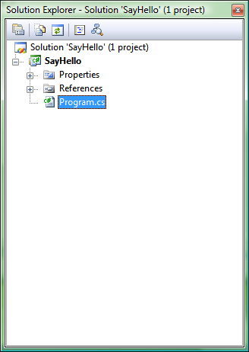
Solution Explorer
▪▪ Will contain at least one project
□□ Contains one or more source code files
□□ Each project produces an assembly
▪▪ Projects organized under a solution
□□ Manage multiple applications or libraries

Slide 10
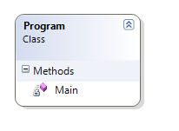
Types
▪▪ C# is strongly typed
□□ One way to define a type is to write a class
□□ Every object you work with has a specific type
□□ 1,000s of types are built into the .NET framework
□□ You can define your own custom types
▪▪ Code you want to execute must live inside a type
□□ You can place the code inside a method
□□ We’ll explore other things you can add to a type later …

Slide 11






Is hoursOfSleep less than 8?
Yes No
Tell them they look tired
Tell them they look rested

Slide 12

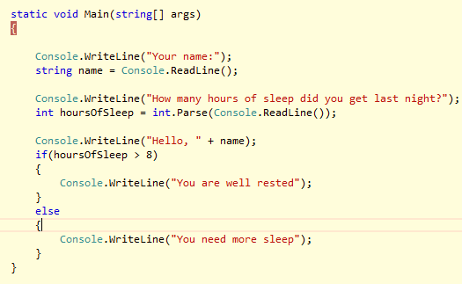
Summary
▪▪ C# is a strongly typed & case sensitive language for .NET
▪▪ Visual Studio is an IDE to work with C# applications of all types

Slide 13
Classes and Objects

Slide 14
We need an electronic grade book to read the scores of an individual student and then compute some simple statistics from the scores.
The grades are entered as floating point numbers from 0 to 100, and the statistics should show us the highest grade, the lowest grade, and the average grade.

Slide 15
Constructors
GradeBook book = new GradeBook();
▪▪ Special methods used to initialize objects
public GradeBook()
{
// ... initialization code
}

Slide 16
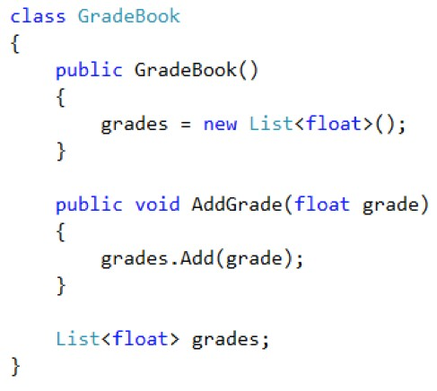
Classes Versus Variables
▪▪ A class is a blueprint for creating objects
▪▪ A class can also be used to type a variable
□□ A variable can refer to any object of the same type
GradeBook Object
New
GradeBook book;

Slide 17
Reference Types
…
6
7
GradeBook Object
10
…
▪▪ Classes are reference types
▪▪ Variables hold a pointer value
GradeBook book1 = new GradeBook();
8
9
GradeBook book2 = book1;

Slide 18
Statics
▪▪ Use static members of a class without creating an instance
public static float MinimumGrade = 0; public static float MaximumGrade = 100;
Console.WriteLine(“Hello!”); Console.WriteLine(GradeBook.MaximumGrade);

Slide 19
Classes
▪▪ A class definition creates a new type
□□ Use the type for variables and arguments
▪▪ Use a class to create objects
□□ Invoke methods and save state in objects

Slide 20
Object Oriented Programming
▪▪ Objects are nouns
▪▪ Methods are verbs
▪▪ Objects encapsulate functionality

Slide 21






Encapsulation
LowGrade
AvgGrade
HighGrade
GradeBookStatistics

Slide 22

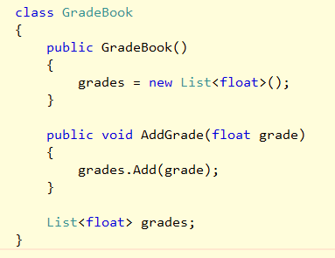





Access Modifiers
public
Constructor
AddGrade
private
grades

Slide 23
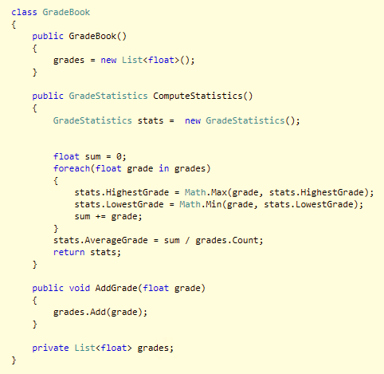
Summary

Slide 24
Assemblies

Slide 25
csc.exe
The C# Command Line Compiler
csc.exe
myapp.exe
file.cs
Assembly

Slide 26
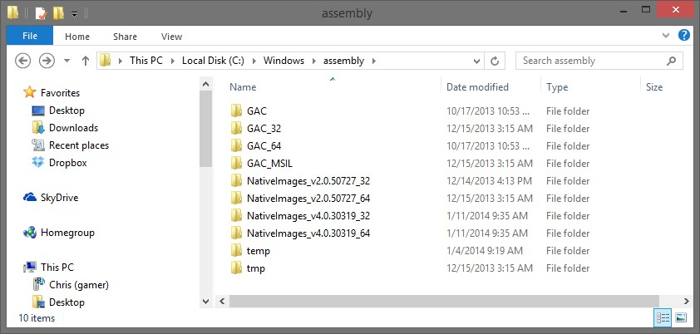
Assemblies
▪▪ Assemblies are .exe or .dll files
□□ Contain metadata about all types inside
▪▪ Global Assembly Cache
□□ A central location to store assemblies for a machine

Slide 27
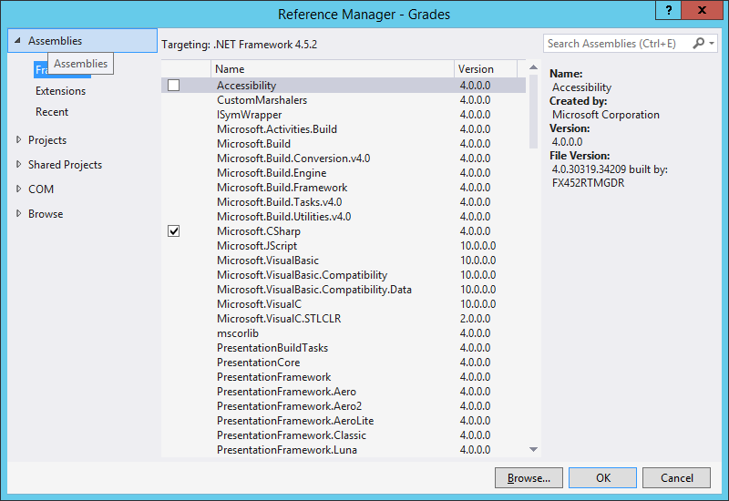
References
▪▪ Must load assembly into memory before using types inside
□□ Easy approach – reference the assembly in Visual Studio

Slide 28
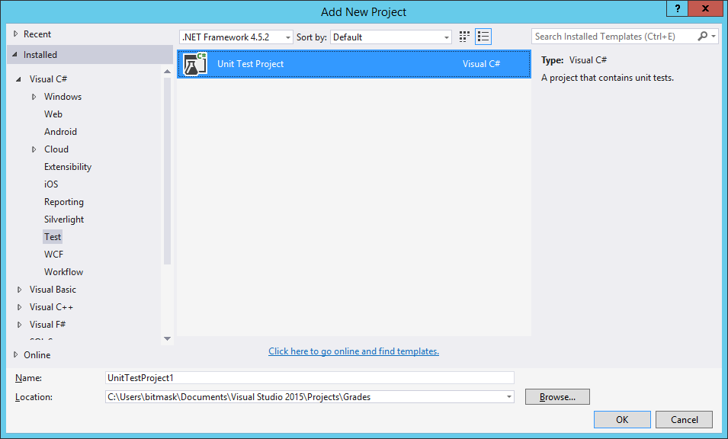
Unit Testing
▪▪ Write code to test code!

Slide 29
Access Modifiers
Keyword | Visibility
public | Everywhere
private | Only in the same class
internal | Only in the same assembly

Slide 30
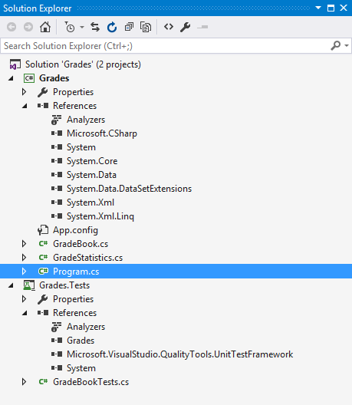
Summary

Slide 31
Types

Slide 32
Reference Types
▪▪ Variables store a reference to an object
□□ Multiple variables can point to the same object
□□ Single variable can point to multiple objects over it’s lifetime
□□ Objects allocated into memory using new
GradeBook
g1
g2
GradeBook
g3

Slide 33
GradeBook
g1
g2
GradeBook Name=“Scott’s Book”

Slide 34
Value Types
▪▪ Variables hold the value
□□ No pointers, no references
▪▪ Many built-in primitives are value types
□□ int, double, float
g1
GradeBook Name=“Scott’s Book”
g2
x1 100
x2 4

Slide 35
GradeBook
g1
g2
GradeBook Name=“Scott’s Book”

Slide 36
GradeBook
g1
g2
GradeBook
Name = “The New Gradebook”
book

Slide 37
Creating Value Types
▪▪ struct definitions create value types
□□ Should represent a single value
□□ Should be small
public struct DateTime
{
// ...
}

Slide 38
Enumerations
▪▪ An enum creates a value type
□□ A set of named constants
□□ Underlying data type is int by default
public enum PayrollType { Contractor = 1, Salaried, Executive,
Hourly } | if(employ { | ee.Role == PayrollType.Hourly)
 | // ... }

Slide 39
Method Parameters
▪▪ Parameters pass “by value”
□□ Reference types pass a copy of the reference
□□ Value types pass a copy of the value
public void DoWork(GradeBook book)
{
book.Name = “Grades”;
}

Slide 40
Immutability
▪▪ Value types are usually immutable
□□ Can not change the value of 4
□□ Can not change the value of August 9th, 2002
DateTime date = new DateTime(2002, 8, 11); date.AddDays(1)
string name = " Scott "; name.Trim();

Slide 41
Arrays
▪▪ Manage a collection of variables
□□ Fixed size
□□ Always 0 indexed
const int numberOfStudents = 4;
int[] scores = new int[numberOfStudents];
int totalScore = 0; foreach(int score in scores)
{
totalScore += score;
}
double averageScore = (double)totalScore / scores.Length;

Slide 42
grades
0
0
0
AddGrades grades
0
89.1
0
0 0

Slide 43
Assemblies
▪▪ Assemblies are .exe or .dll files
□□ Contain metadata about all types inside
▪▪ Global Assembly Cache
□□ A central location to store assemblies for a machine

Slide 44
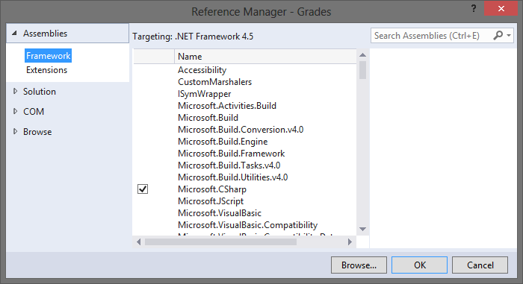
References
▪▪ Must load assembly into memory before using types inside
□□ Easy approach – reference the assembly in Visual Studio

Slide 45
Summary
▪▪ Every type is a value type or reference type
□□ Use struct to create a value type
□□ Use class to create a reference type
▪▪ Arrays and strings are reference types
□□ Strings behave like a value type

Slide 46
Methods, Fields, Events, and Properties

Slide 47
Methods
▪▪ Methods define behavior
▪▪ Every method has a return type
□□ void if no value returned
▪▪ Every method has zero or more parameters
□□ Use params keyword to accept a variable number of parameters
▪▪ Every method has a signature
□□ Name of method + parameters
public void WriteAsBytes(int value)
{
byte[] bytes = BitConverter.GetBytes(value);
foreach(byte b in bytes)
{
Console.Write("0x{0:X2} ", b);
}
}

Slide 48
Method Overloading
▪▪ Define multiple methods with the same name in a single class
□□ Methods require a unique signature
▪▪ Compiler finds and invokes the best match
public void WriteAsBytes(int value)
{
// ...
}
public void WriteAsBytes(double value)
{
// ...
}

Slide 49
Methods - Review
▪▪ Instance methods versus static methods
□□ Instance methods invoked via object, static methods via type
▪▪ Abstract methods
□□ Provide no implementation, implicitly virtual
▪▪ Virtual methods
□□ Can override in a derived class
▪▪ Partial methods
□□ Part of a partial class
▪▪ Extension methods
□□ Described in the LINQ module

Slide 50
Fields
▪▪ Fields are variables of a class
□□ Can be read-only
public class Animal
{
private readonly string _name;
public Animal(string name)
{
_name = name;
}
}

Slide 51
Properties
▪▪ A property can define a get and/or set accessor
□□ Often used to expose and control fields
▪▪ Auto-implemented properties use a hidden field
private string _name;
public string Name
{
get { return _name; } set
{
if(!String.IsNullOrEmpty(value))
{
_name = value;
}
}
}
public string Name
{
get; set;
}

Slide 52
Events
▪▪ Allows a class to send notifications to other classes or objects
□□ Publisher raises the event
□□ One or more subscribers process the event
Button
Click
subscriber
subscriber
subscriber
subscriber

Slide 53
Delegates
▪▪ I need a variable that references a method
▪▪ A delegate is a type that references methods
public delegate void Writer(string message);
Logger logger = new Logger(); Writer writer = new Writer(logger.WriteMessage);
writer("Success!!");
 | { public void WriteMessage(String message) { Console.WriteLine(message); } }
public class Logger

Slide 54
Subscribing To Events
▪▪ Use the += and -= to attach and detach event handlers
□□ Can attached named or anonymous methods
public static void Initialize()
{
_submitButton.Click += new RoutedEventHandler(_submitButton_Click);
}
static void _submitButton_Click(object sender, RoutedEventArgs e)
{
// ... respond to event
}

Slide 55
Publishing Events
▪▪ Create custom event arguments (or use a built-in type)
□□ Always derive from the base EventArgs class
▪▪ Define a delegate (or use a built-in delegate)
▪▪ Define an event in your class
▪▪ Raise the event at the appropriate time
public event NameChangingEventHandler NameChanging;
private bool OnNameChanging(string oldName, string newName)
{
if(NameChanging != null)
{
NameChangingEventArgs args = new NameChangingEventArgs(); args.Cancel = false;
args.NewName = newName; args.OldName = oldName;
NameChanging(this, args);
}
}

Slide 56
Summary
▪▪ Members are used to craft an abstraction
□□ Fields and properties for state
□□ Methods for behavior
□□ Events for notification

Slide 57
Control Flow

Slide 58

Overview
▪▪ Branching
▪▪ Iterating
▪▪ Jumping
▪▪ Exceptions

Slide 59
Branching
if (age <= 2)
ServeMilk(); else if (age < 21)
ServeSoda();
else
{
ServeDrink();
}
if (age <= 2)
{
if(name == "Scott")
{
// ...
}
}
string pass = age > 20 ? "pass" : "nopass";

Slide 60
Switching
▪▪ Restricted to integers, characters, strings, and enums
□□ Case labels are constants
□□ Default label is optional
switch(name) { case "Scott":
ServeSoda(); break;
case "Alex":
ServeMilk(); ServeDrink(); break;
default:
ServeMilk(); break;
}

Slide 61
Iterating
for(int i = 0; i < age; i++)
{
while(age > 0)
Console.WriteLine(i);
{
}
age -­‐= 1;
Console.WriteLine(age);
do
}
{
age++; Console.WriteLine(age);
} while (age < 100);
= {2, 21, 40, 72, 100};
int[] ages
foreach (i
{
Consol
nt value in ages)
e.WriteLine(value);
}

Slide 62
Iterating with foreach
▪▪ Iterates a collection of items
□□ Uses the collection’s GetEnumerator method
int[] ages = {2, 21, 40, 72, 100}; foreach (int value in ages) { Console.WriteLine(value); }
 | int[] ages = {2, 21, 40, 72, 100};
 | IEnumerator enumerator = ages.GetEnumerator(); while(enumerator.MoveNext()) { Console.WriteLine((int)enumerator.Current); }

Slide 63
Jumping
▪▪ break
▪▪ continue
▪▪ goto
▪▪ return
▪▪ throw
foreach(int age in ages) { if(age == 2) { continue; } if(age == 21) { break;
} } | foreach(int age in ages) if(age == 2) { | {
 | goto skip; } // ... skip: Console.WriteLine("Hello!"); }

Slide 64
Returning
▪▪ You can use return in a void method
void CheckAges()
{
foreach (int age in ComputeAges())
{
if (age == 21) return;
}
}

Slide 65
Throwing
▪▪ Use throw to raise an exception
□□ Exceptions provide type safe and structured error handling in .NET
▪▪ Runtime unwinds the stack until it finds a handler
□□ Unhandled exception will terminate an application
if(age == 21)
{
throw new ArgumentException("21 is not a legal value");
}

Slide 66
Built-in Exceptions
▪▪ Dozens of exceptions already defined in the BCL
□□ All derive from System.Exception
Type | Description
System.DivideByZeroException | Attempt to dividean integral value by zero occurs.
System.IndexOutOfRangeException | Attempt to index an array via an index that is outside the bounds of the array.
System.InvalidCastException | Thrown when an explicit conversion from a base type or interface to a derived type fails at run time.
System.NullReferenceException | Thrown when a null reference is used in a way that causes the referenced object to be required.
System.StackOverflowException | Thrown when the execution stack is exhausted by having too many pending method calls.
System.TypeInitializationException | Thrown when a static constructor throws an exception, and no catch clauses exists to catch it.

Slide 67
Handling Exceptions
▪▪ Handle exceptions using a try block
□□ Runtime will search for the closest matching catch statement
try
{
ComputeStatistics();
}
catch(DivideByZeroException ex)
{
Console.WriteLine(ex.Message); Console.WriteLine(ex.StackTrace);
}

Slide 68
Chaining Catch Blocks
▪▪ Place most specific type in the first catch clause
▪▪ Catching a System.Exception catches everything
□□ … except for a few “special” exceptions
try {
// ...
}
catch(DivideByZeroException ex)
{
// ...
}
catch(Exception ex)
{
// ...
}

Slide 69
Finally
▪▪ Finally clause adds finalization code
□□ Executes even when control jumps out of scope
FileStream file = new FileStream("file.txt", FileMode.Open);
try
{
}
finally
{
file.Close();
}
 | using(FileStream file1 = new FileStream("in.txt", FileMode.Open)) using(FileStream file2 = new FileStream("out.txt", FileMode.Create)) { // ... }

Slide 70
Re-throwing Exceptions
▪▪ For logging scenarios
□□ Catch and re-throw the original exception
▪▪ For the security sensitive
□□ Hide the original exception and throw a new, general error
▪▪ For business logic
□□ Useful to wrap the original exception in a meaningful exception
try
{
// ...
}
catch(Exception ex)
{
// log the error ... throw;
try
{
// ...
}
catch(DivideByZeroException ex)
{
throw new
InvalidAccountValueException("...", ex);
}
}

Slide 71
Custom Exceptions
▪▪ Derive from a common base exception
▪▪ Use an Exception suffix on the class name
public class InvalidAccountException : Exception
{
public InvalidAccountException() { }
public InvalidAccountException(string message) : base(message) { } public InvalidAccountException(string message, Exception inner)
: base(message, inner) { }
}

Slide 72
Letter Grades
Letter Grades
90-100 | A
80-89 | B
70-79 | C
60-69 | D
0-59 | F

Slide 74
Summary
▪▪ Flow control statements fall into three categories
▪▪ Branching
▪▪ Looping
▪▪ Jumping
▪▪ Exceptions provide structured error handling
▪▪ Throw exceptions (built-in or custom)
▪▪ Catch exceptions

Slide 75
Object Oriented Programming

Slide 76
Pillars of OOP
Encapsulation
Inheritance
Polymorphism
Abstraction

Slide 77

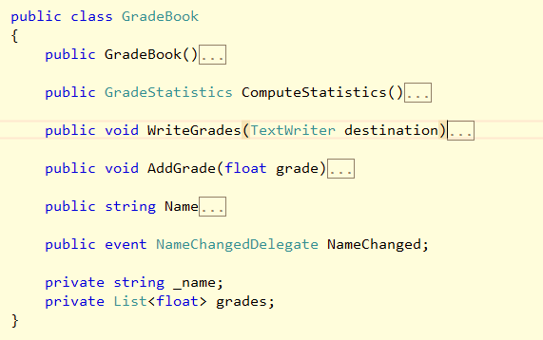

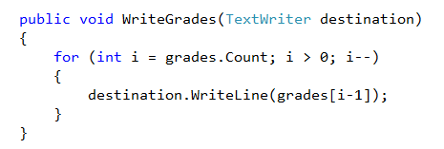
Encapsulation

Slide 78

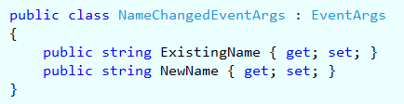

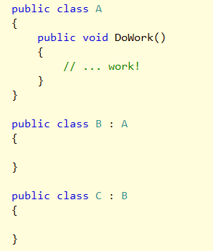
Inheritance

Slide 79

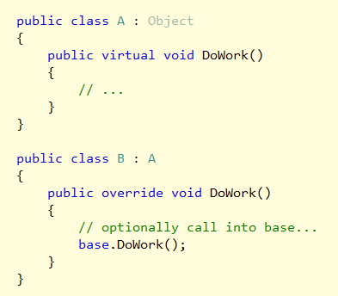
Polymorphism
▪▪ Polymorphism == “many shapes”
□□ One variable can point to different types of objects
□□ Objects can behave differently depending on their type

Slide 80

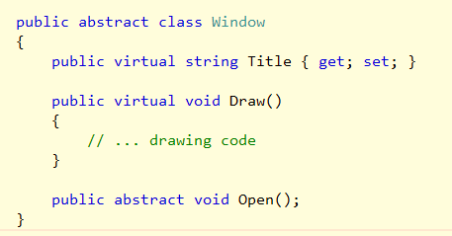
Abstract Classes
▪▪ Abstract classes cannot be instantiated
□□ Can contain abstract members

Slide 81

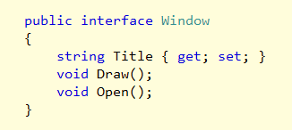
Interfaces
▪▪ Interfaces contain no implementation details
□□ Defines only the signatures of methods, events, and properties
▪▪ A type can implement multiple interfaces

Slide 82
Important Interfaces
Name | Description
IDisposable | Release resources (files, connections)
IEnumerable | Supports iteration (foreach)
INotifyPropertyChange | Raises events when properties change
IComparable | Compares for sorting

Slide 83

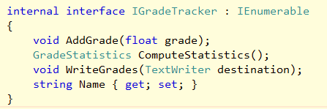
Summary

